Slide 1
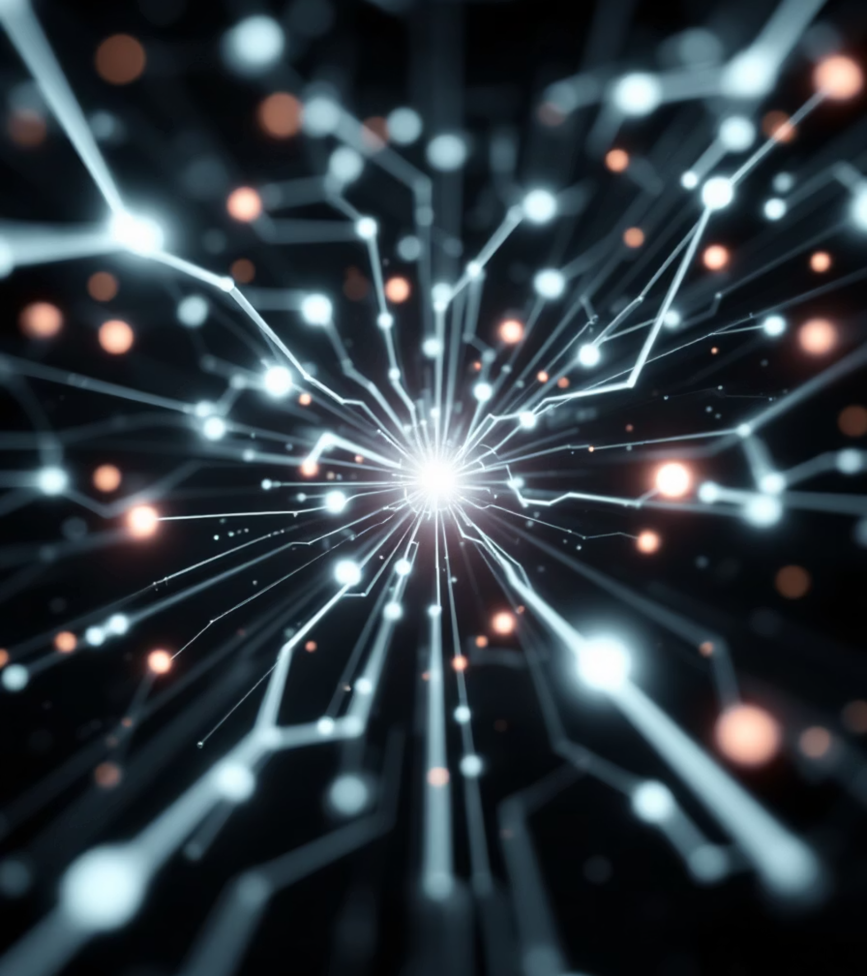
AI-Driven Cyber Threat Detection Platform
A system designed to understand and visualise cyber threats in real time.

Slide 2
Why This Problem Matters
Background
Challenge:
Digital systems are highly connected today.
Data exists, but clarity and awareness are missing.
Cyber attacks occur through files, links, networks, and online services.
Security information is available, but it is scattered.
Understanding threats quickly is difficult for humans.

Slide 3
Problem Statement
Core Issue Identified
Fast & Complex
Raw Data
Cyber threats are fast, complex, and continuous.
Existing security tools show alerts and raw data.
Manual Work
Delayed Response
Analysts must manually interpret multiple sources.
This causes delayed understanding and slow response.
👉 There is a need for a unified and intelligent awareness system.

Slide 4
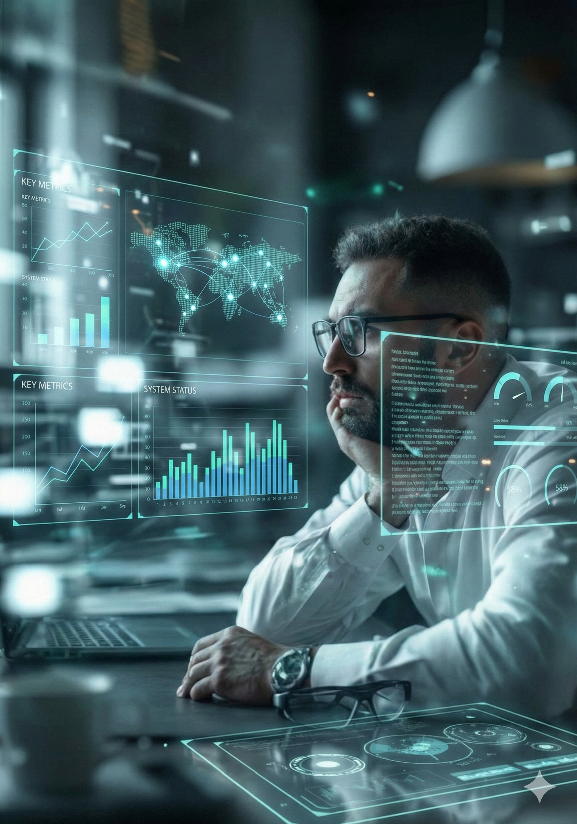
Thought Process
How We Approached the Problem
Instead of focusing only on detection, we focused on:
Human understanding
Clear explanations
Visual representation
Real-time awareness
Objective: Make cybersecurity easier to understand and act upon.

Slide 5

Central Idea
What the Proposed System Does
The proposed solution:
Observes multiple cyber threat sources
Analyses activity continuously
Explains risks in simple language
Presents insights visually
It works as a decision-support system for cybersecurity.

Slide 6


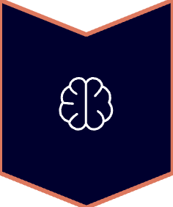


Solution Approach
High-Level Working Model
Monitor different entry points
Analyse behaviour and patterns
Apply intelligence to assess risk
Convert data into meaningful insights
Display results in an easy-to-understand format
Focus: Insight over information overload.

Slide 7
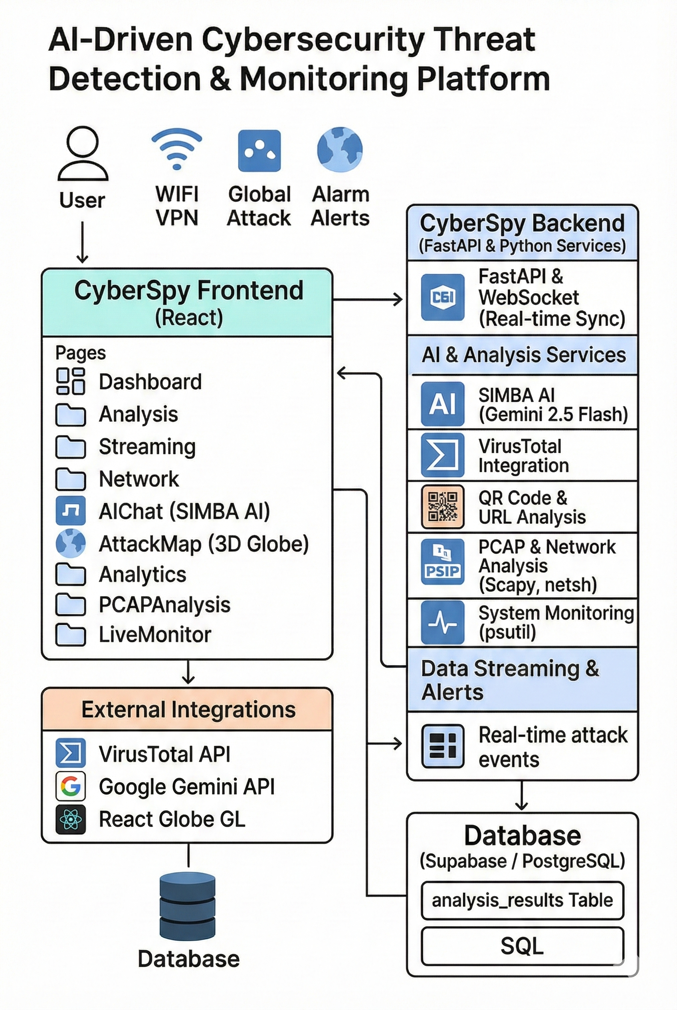
System Architecture (Overview)
Unified frontend for user interaction and visualization
2. Central backend for analysis, intelligence, and real-time processing
3. AI and external services support threat understanding
4. Database stores analysis results and history
👉 Overall: The architecture is designed to collect data, analyze threats, and present insights in real time.

Slide 8
Prediction & Intelligence Approach
Instead of using a traditional trained ML prediction model, the system uses intelligent analysis and AI reasoning.
Incoming data from files, URLs, networks, and streams is analyzed in real time to estimate risk and threat severity
The frontend sends user inputs to the backend APIs, where analysis and AI-based interpretation are performed.
The backend returns risk scores, summaries, and insights, which are visualized instantly on the frontend.
👉 Prediction here means: Understanding and assessing threats dynamically, not forecasting with a static model.

Slide 9

Coverage Areas
Threat Scenarios Considered
The system addresses common real-world threats:
File-based attacks
Live network activity
Malicious URLs and phishing
System-level anomalies
Unsafe wireless networks
Global attack trends
QR-code related fraud
This ensures holistic security awareness.

Slide 10
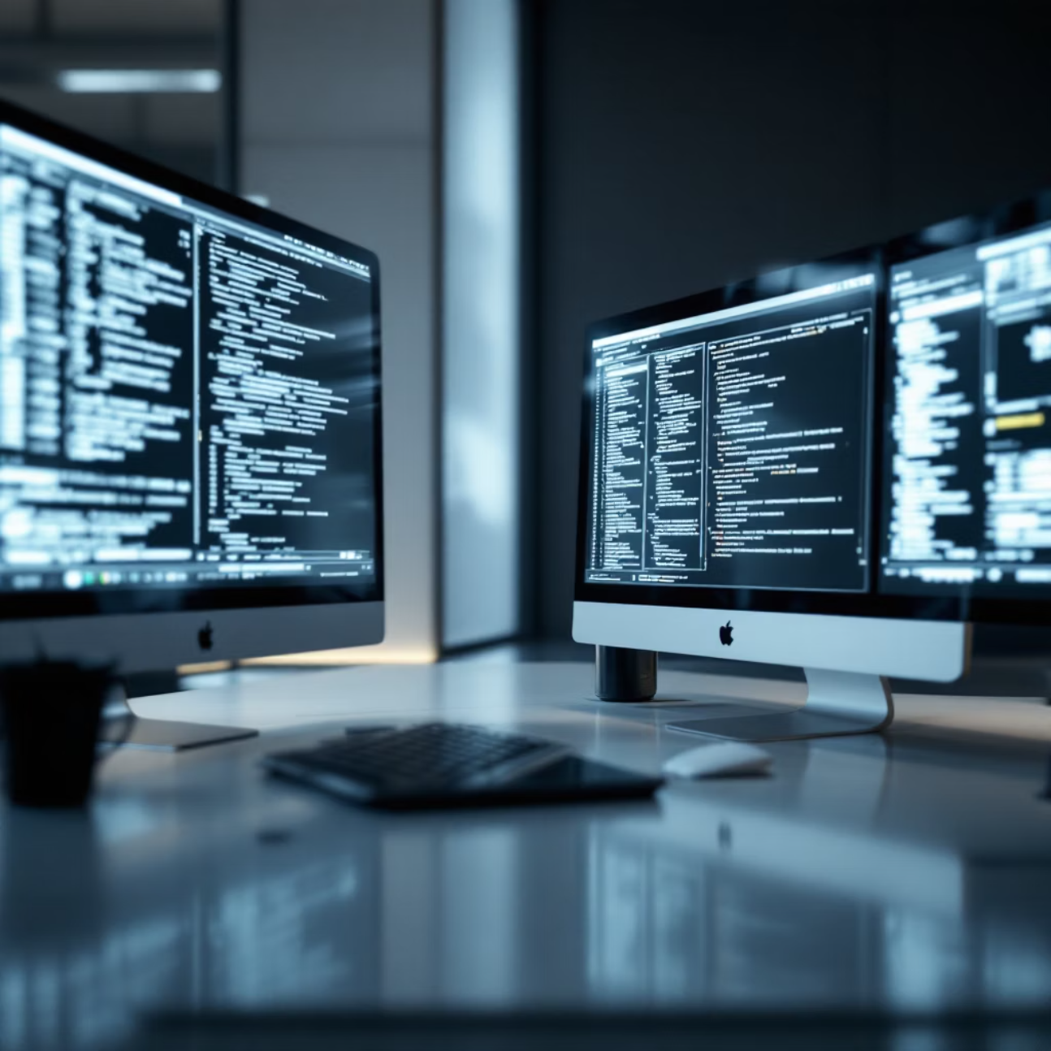
Role of Intelligence
Why Intelligent Analysis Is Required
Raw logs are difficult to interpret.
Intelligent analysis helps to:
Summarise threats
Explain severity and impact
Assist faster decision-making
The system supports human judgement, not replaces it.

Slide 11
Outcomes and Impact
What the System Achieves
Faster threat understanding
Reduced manual analysis
Improved situational awareness
Better learning for students and analysts
Unified view of cybersecurity data
Complex threats become clear and actionable.

Slide 12
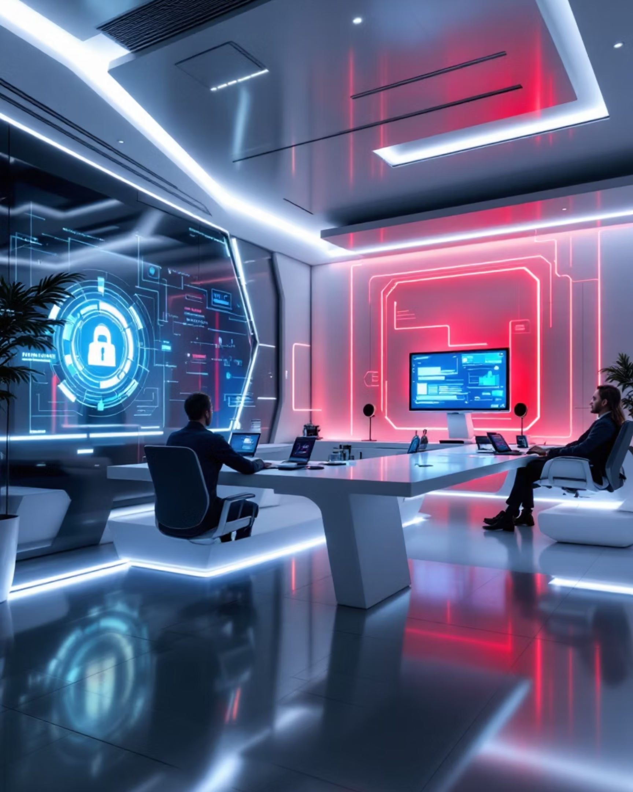
Conclusion & Vision
Final Takeaway
This work demonstrates how:
Intelligence + visualisation
Real-time data + human-centric design
can transform cybersecurity from reactive monitoring to proactive awareness.
Understanding threats is the first step to preventing them.

